Slide 1
Calculator Review Fractions
College Algebra

Slide 2
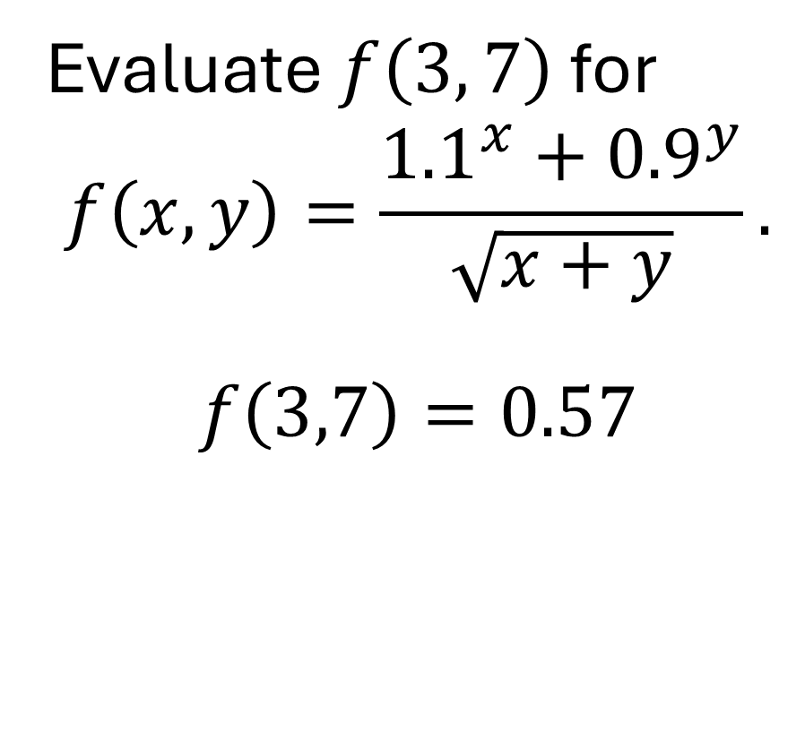
Example
Evaluate $f\left(3, 7\right)$ for $$f\left(x,y\right)=\frac{{1.1}^{x}+{0.9}^{y}}{\sqrt{x+y}}.$$
$$f\left(3,7\right)=0.57$$

